Slide 1
Network Effects and the Diffusion of Communications
Technologies and Computer Hardware and Software
Jean Bella
Fayyaz M Adil

Slide 2
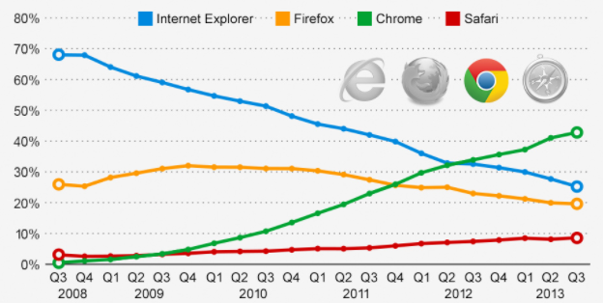
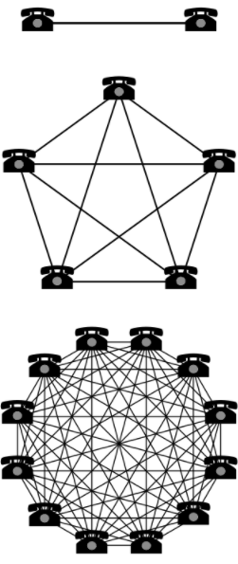
CASE SURVEY
A network effect (or network externality or demand-side economies of scale) is the effect described in economics and business that an additional user of goods or services has on the value of that product to others.
Network effect of Google chrome

Slide 3

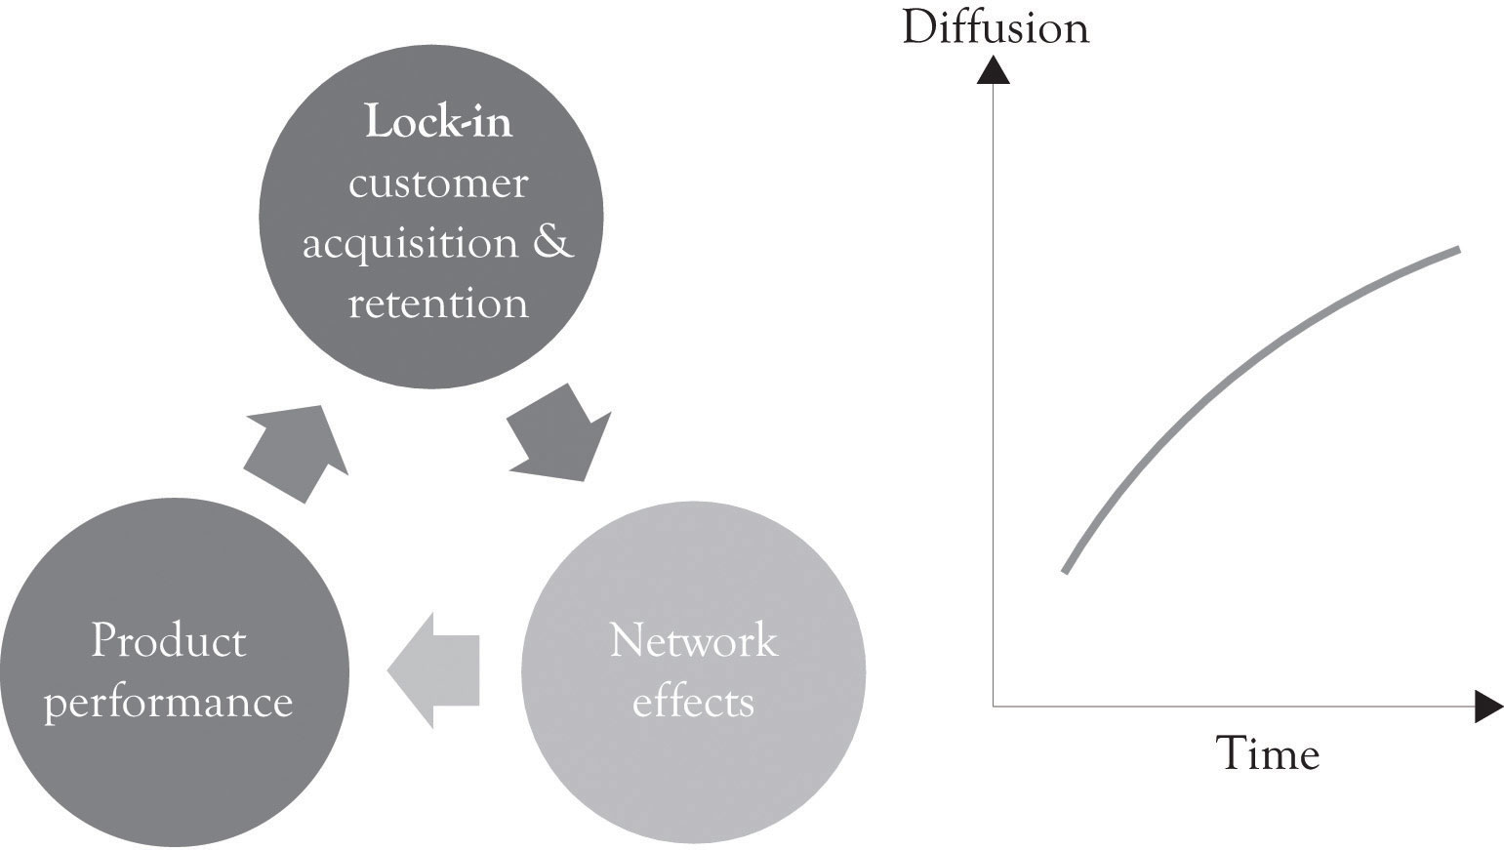
DEFINITION OF THE ECONOMICS TERMS AND NOTIONS
Bandwagon effect
A psychological phenomenon in which people do something primarily because other people are doing it, regardless of their own beliefs, which they may ignore or override.
Lock-in effects
A practice, where a company makes it extremely hard for their customers to leave them, even if the customer wants to.
Critical mass phenomena
Critical mass is a sufficient number of adopters of a new idea, technology or innovation in a social system so that the rate of adoption becomes self-sustaining and creates further growth.
Diffusion
A theory that seeks to explain how, why, and at what rate new ideas and technology spread.
Product performance
The response of a product to external actions in its working environment

Slide 4
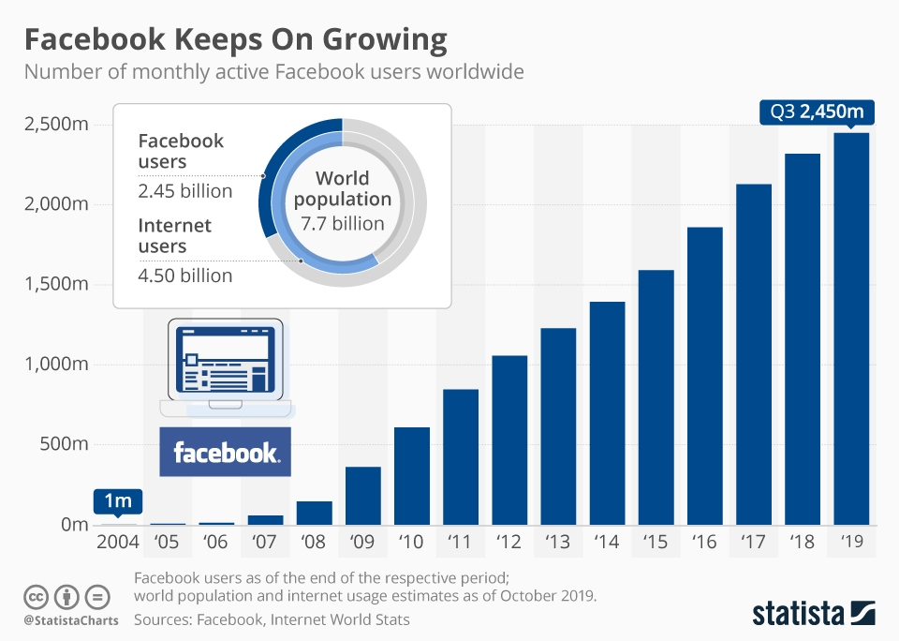
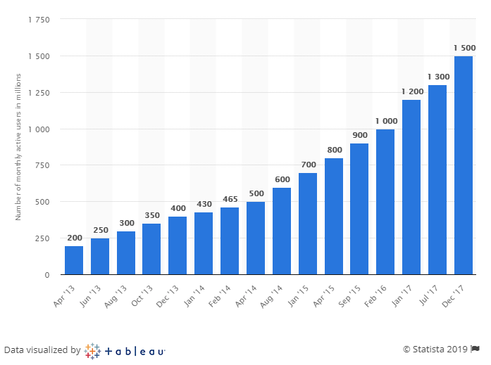
ECONOMIC MODELING
WhatsApp Vs. Facebook
2009: Facebook really get known with sufficient number of adopters then starts create further growth.
Critical mass phenomena
High diffusion rate

Slide 5
ECONOMIC MODELING
Fierce concurrence despite huge community leading to improve of the offer or the service.
e.g: Facebook and snapchact
Product performance
Lock-in effect
The repurchase of whatsApp by FaceBook increased their network
effect since
Apps work for each other.
regroup most of features need for users.
But no increase in cost

Slide 6
THANK YOU
References
https://www.statista.com/chart/10047/facebooks-monthly-active-users/
https://digital.hbs.edu/platform-digit/submission/whatsapp-network-effects-worth-19-billion/h
Steve Lohr, Google, the new master of network effects; The New York Times . July 7, 2008

